Slide 1
Group 8’s project’s MODULEs and packets used
Members:
Mai Xuân Bách
Nguyễn Tuấn Duy
Nguyễn Hồng Anh
Lê Tuấn Minh

Slide 2
LIST OF PACKETS USED
No | Packet
1 | Streamlit
2 | Numpy
3 | Matplotlib
4 | Sympy
5 | Pandas
6 | Time

Slide 3
1. Streamlit
Streamlit is an open source Python library that is usually used to build web apps, geared towards apps for data science and machine learning web apps.
It is compatible with many common Python libraries such as scikit-learn, Keras, PyTorch, SymPy (latex), NumPy, pandas, Matplotlib, and others.
It contains a decent variety of necessary or otherwise useful functions for building a clean and presentable web app UI.
Its’ main selling point is the ease of use and low entry knowledge requirement. The only skill needed to use Streamlit is Python.

Slide 4
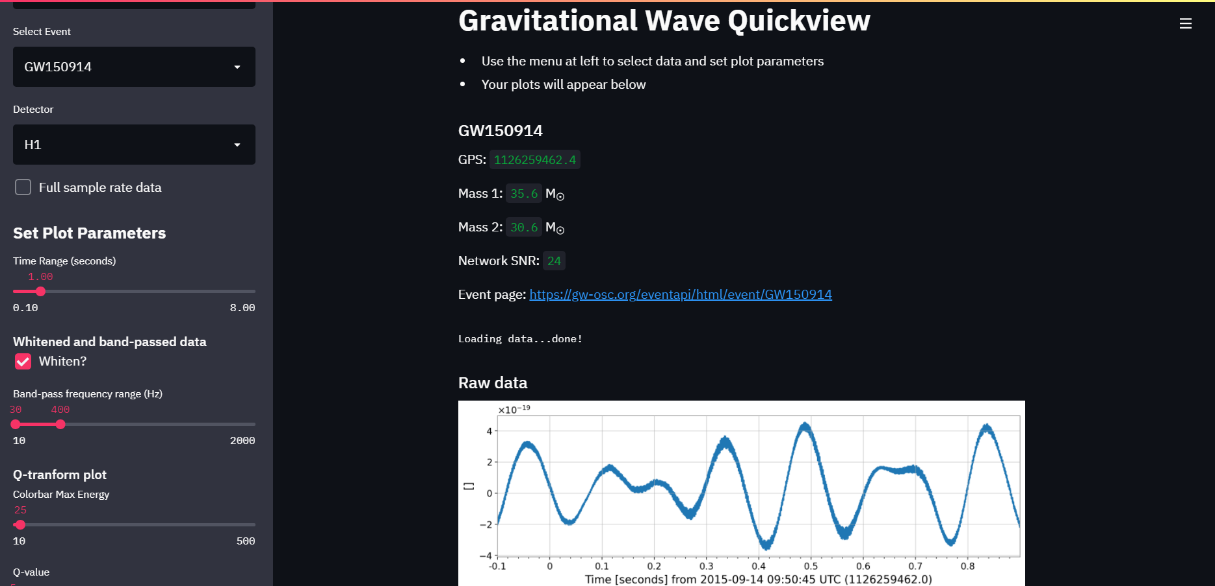
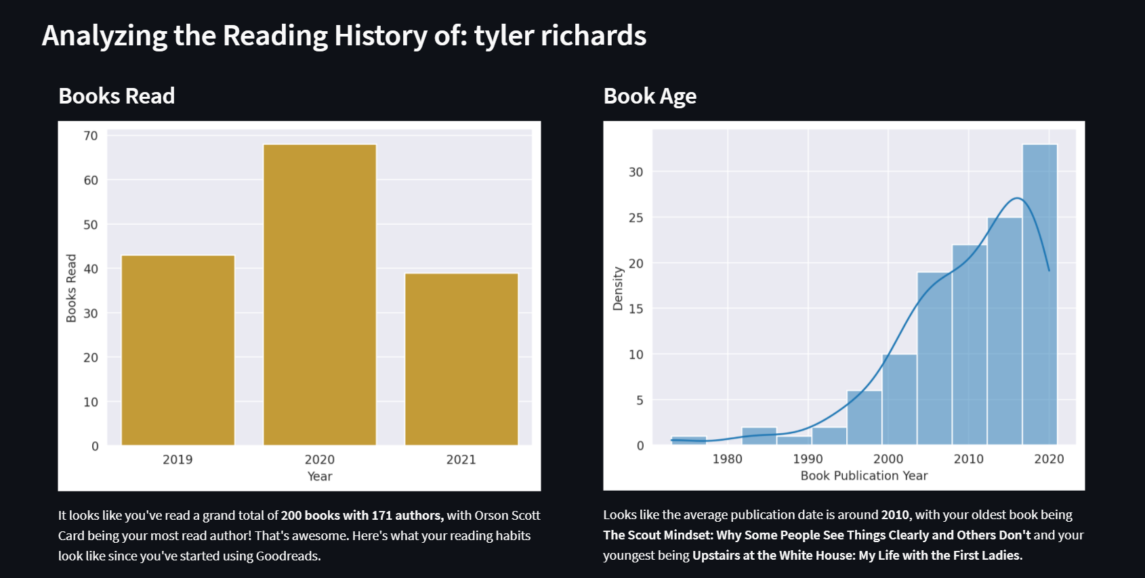
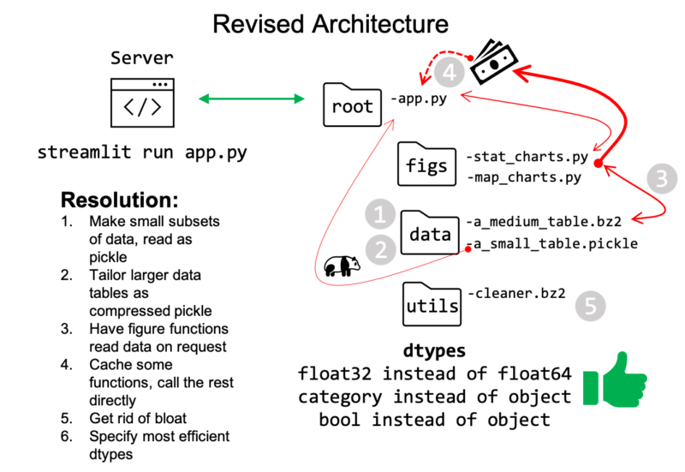
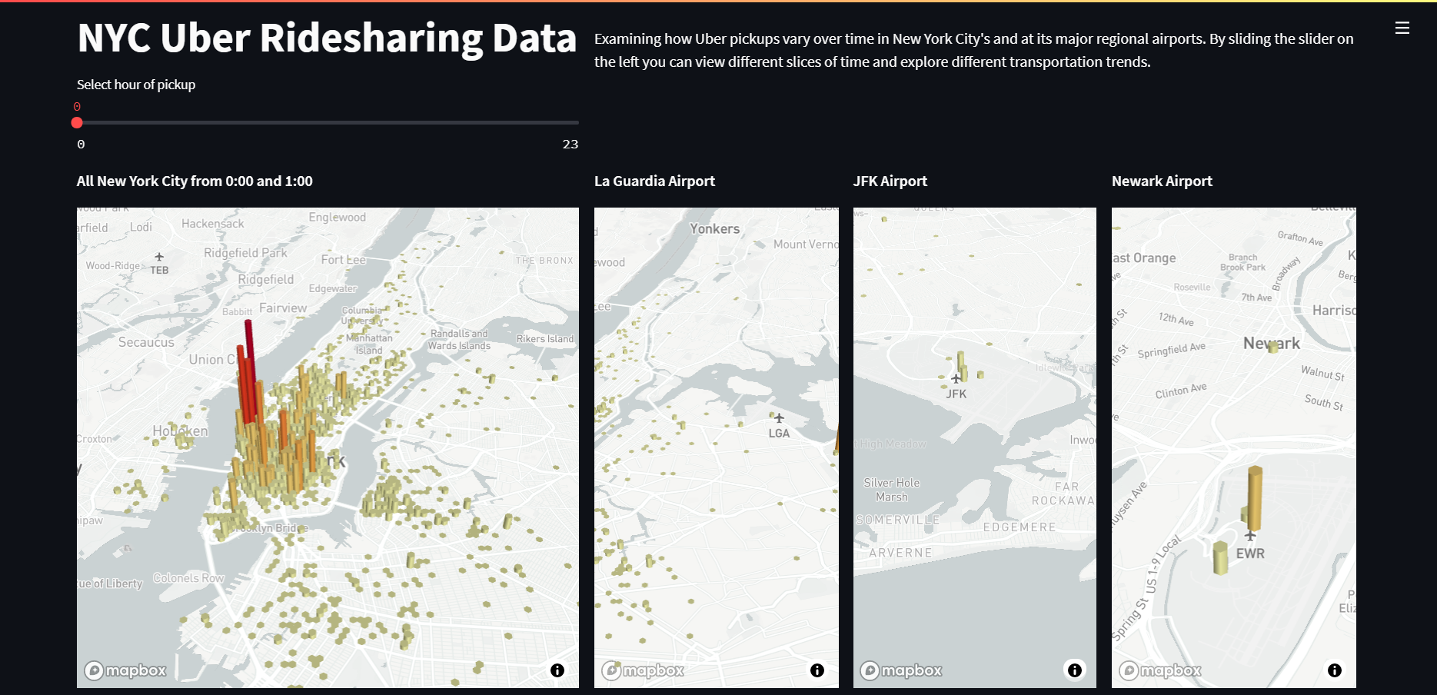
Features:
Architecture streamlining
Display data in intuitive ways
Enable easy parameter setting
Provide clean methods of data presentation

Slide 5
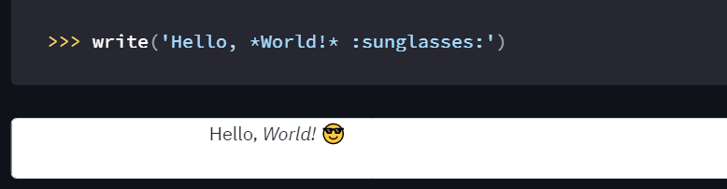
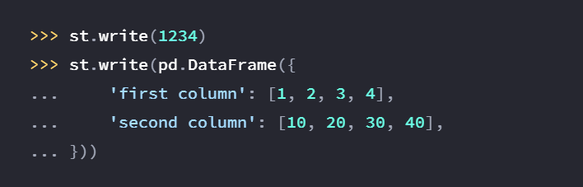
1.1. Streamlit Functions used in project
st.write: Basic writing command. Mainly used for writing instructions and information, as well as results.

Slide 6
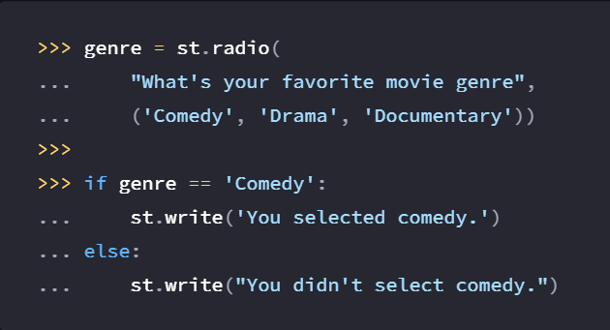
1.1. Streamlit Functions used in project
st.radio: Creates a number of choices, mainly used to navigate between different functions of the application.

Slide 7
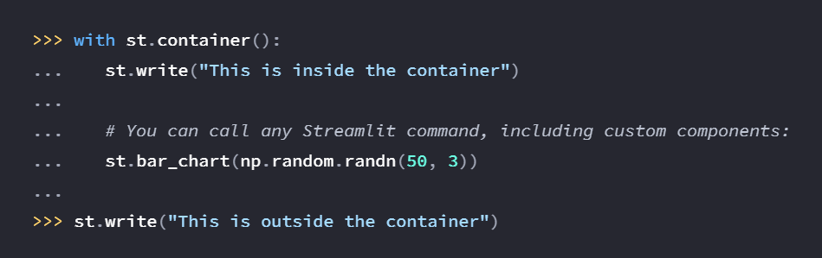
1.1. Streamlit Functions used in project
st.container: Creates and inserts an invisible container that can hold different elements in a web page. Mainly used to group similar or related functions with each other.

Slide 8
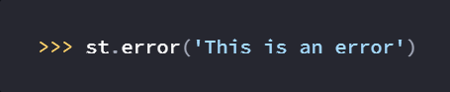
1.1. Streamlit Functions used in project
st.error: Displays an error message.

Slide 9
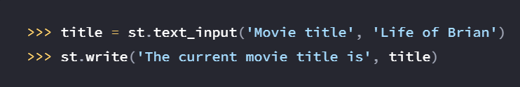
1.1. Streamlit Functions used in project
st.text_input : Displays a single-line text input widget.

Slide 10
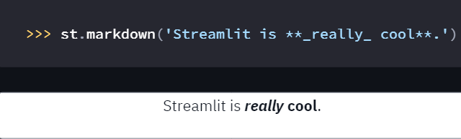
1.1. Streamlit Functions used in project
st.markdown: Displays strings formatted as Markdown.

Slide 11
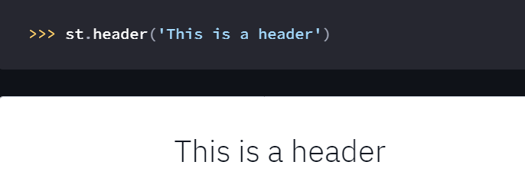
1.1. Streamlit Functions used in project
st.header: Displays text in header formatting.

Slide 12
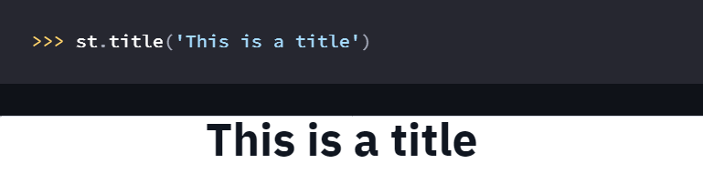
1.1. Streamlit Functions used in project
st.title: Displays text in title formatting.

Slide 13
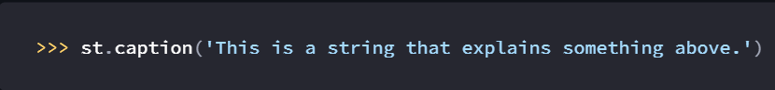
1.1. Streamlit Functions used in project
st.caption: Displays text in little font.

Slide 14
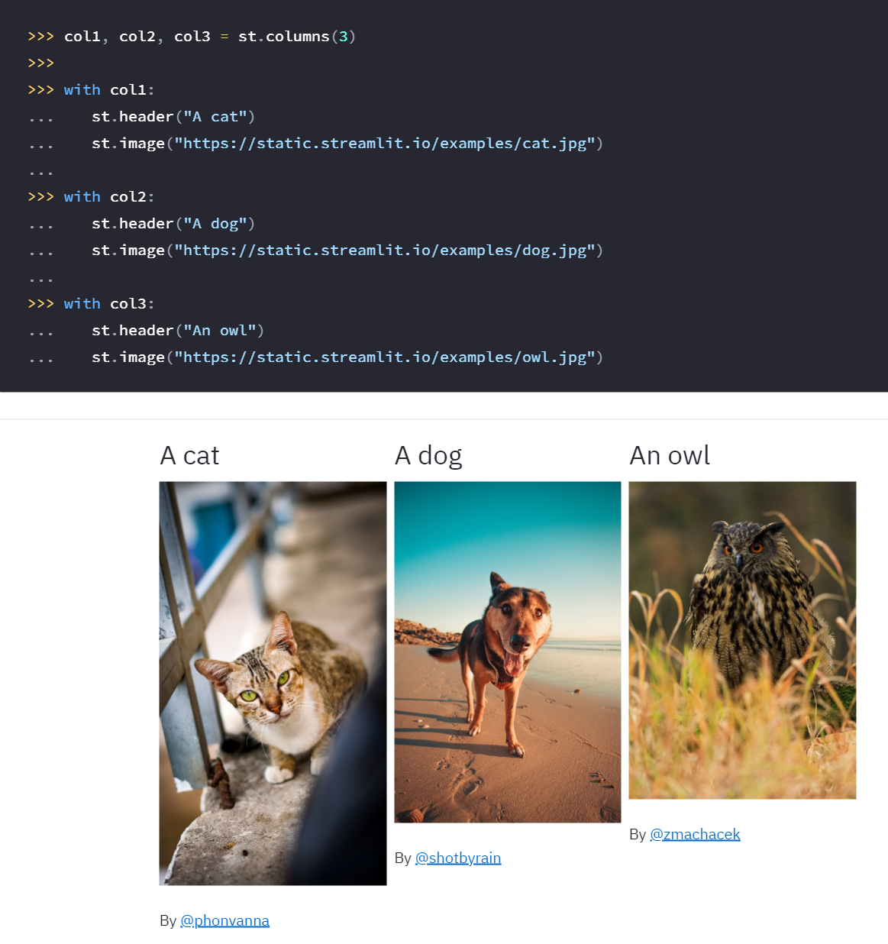
1.1. Streamlit Functions used in project
st.columns: Inserts containers laid out as side-by-side columns.

Slide 15
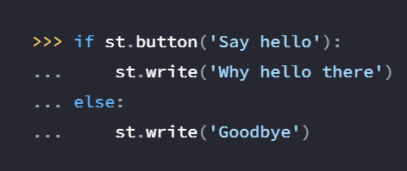
1.1. Streamlit Functions used in project
st.button: Display a button widget.

Slide 16
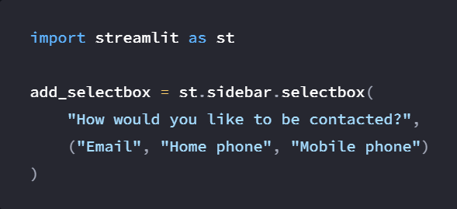
1.1. Streamlit Functions used in project
st.sidebar.selectbox: Adds a select box widget to the sidebar

Slide 17
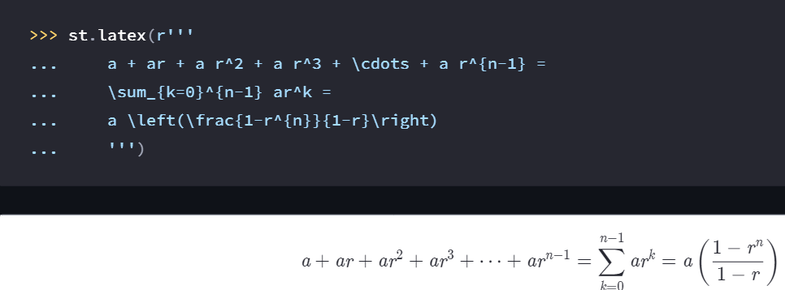
1.1. Streamlit Functions used in project
st.latex: Display mathematical expressions formatted as LaTeX.

Slide 18
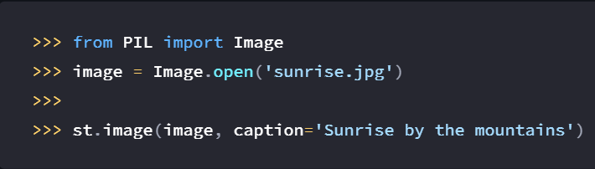
1.1. Streamlit Functions used in project
st.image: Displays an image or list of images.

Slide 19
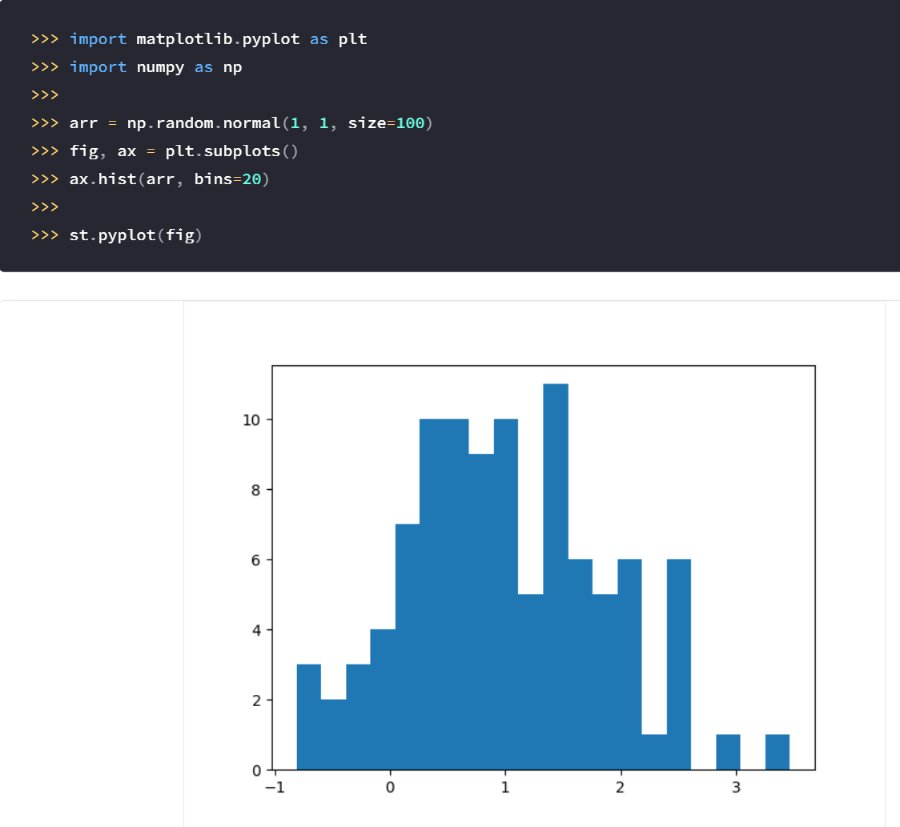
1.1. Streamlit Functions used in project
st.pyplot: Displays a matplotlib.pyplot figure.

Slide 20
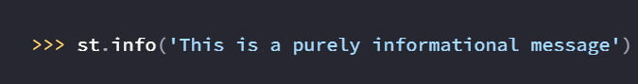
1.1. Streamlit Functions used in project
st.info: Display an informational message.

Slide 21
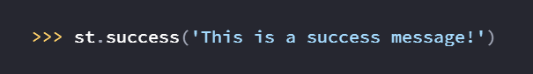
1.1. Streamlit Functions used in project
st.success: Display a success message.

Slide 22
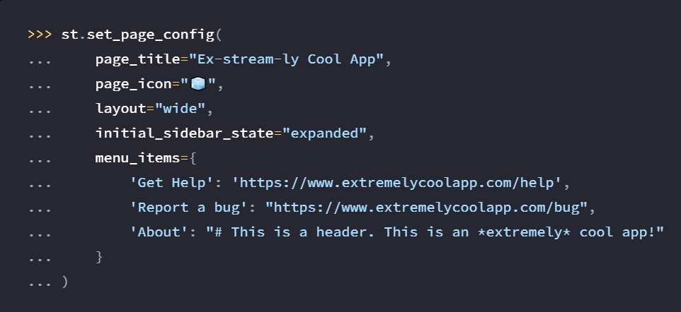
1.1. Streamlit Functions used in project
st.set_page_config(): Configures the default settings of the page.

Slide 23

1.1. Streamlit Functions used in project
st.balloons(): Draw celebratory balloons.

Slide 24

1.1. Streamlit Functions used in project
st.subheader: Displays text in subheader formatting

Slide 25
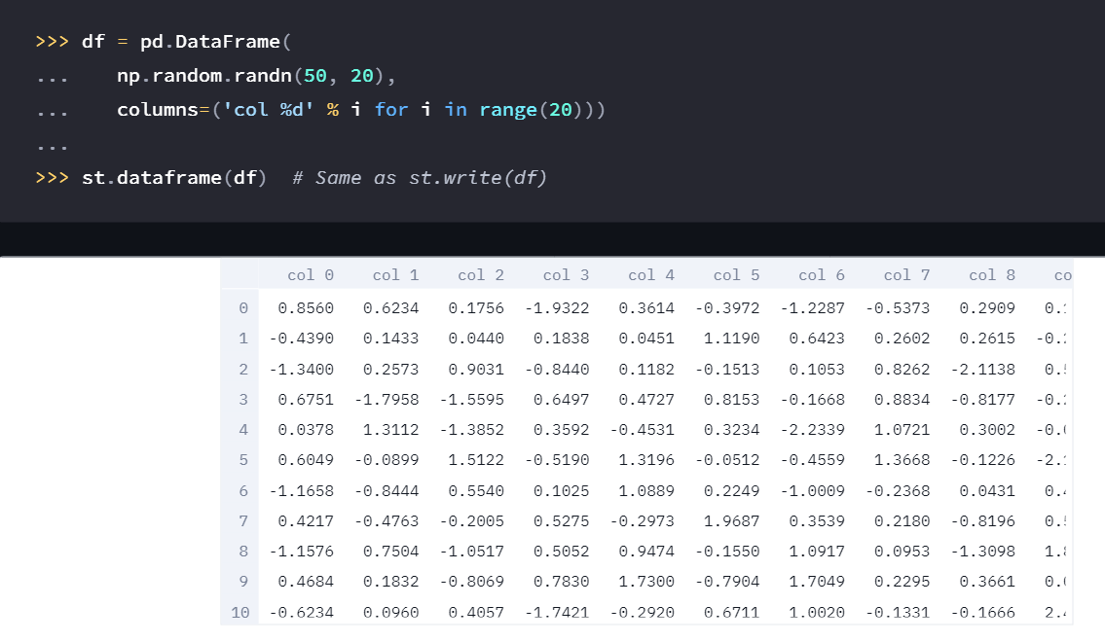
1.1. Streamlit Functions used in project
st.dataframe: Display a dataframe as an interactive table.

Slide 26
2. Numpy
NumPy is the fundamental package for scientific computing in Python.
It is a Python library that provides a multidimensional array object, various derived objects (such as masked arrays and matrices), and an assortment of routines for fast operations on arrays.
It enables operations on mathematical arrays, logical arrays, shape manipulation, sorting, selecting, I/O, discrete Fourier transforms, basic linear algebra, basic statistical operations, random simulation arrays and many more.
It is a near-ubiquitous tool for data manipulation, and serves as the basis of many data tools.

Slide 27
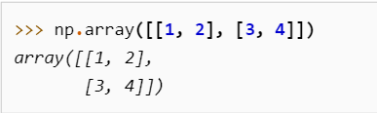
2.1. Numpy Functions used in the project
numpy.array: Creates an array.

Slide 28
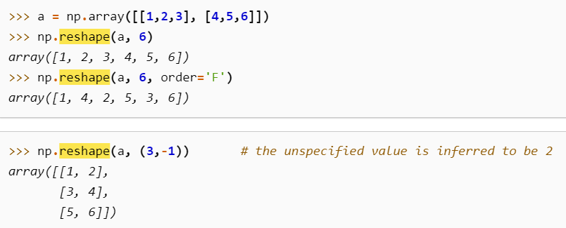
2.1. Numpy Functions used in the project
numpy.reshape: Gives an array a new shape without changing its data.

Slide 29
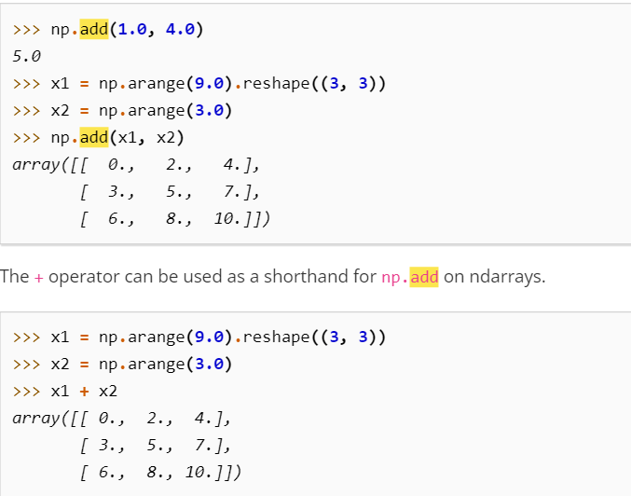
2.1. Numpy Functions used in the project
numpy.add: Adds numpy arguments element wise.

Slide 30
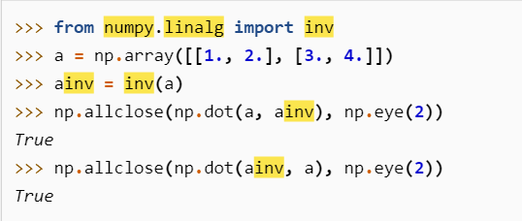
2.1. Numpy Functions used in the project
numpy.linalg.inv: Calculates the inverse of a matrix.

Slide 31
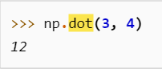
2.1. Numpy Functions used in the project
numpy.dot: Calculates the dot product of 2 arrays.

Slide 32
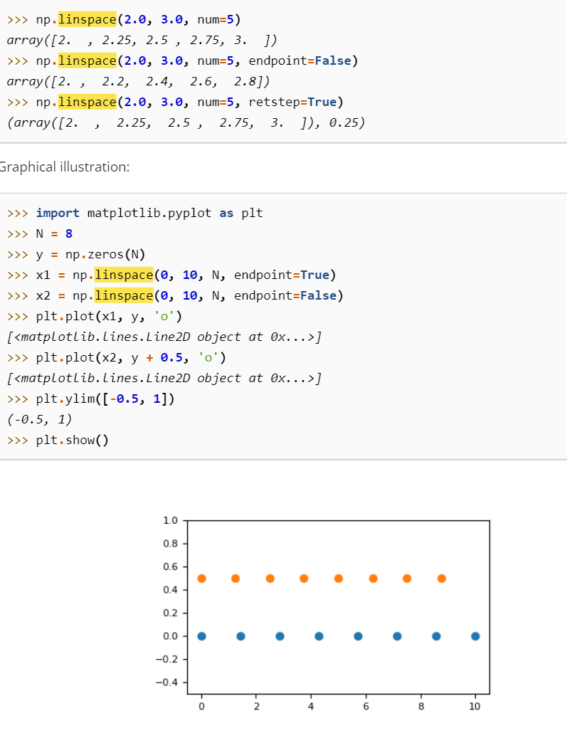
2.1. Numpy Functions used in the project
np.linspace(): Returns evenly spaced numbers over a specified interval.

Slide 33
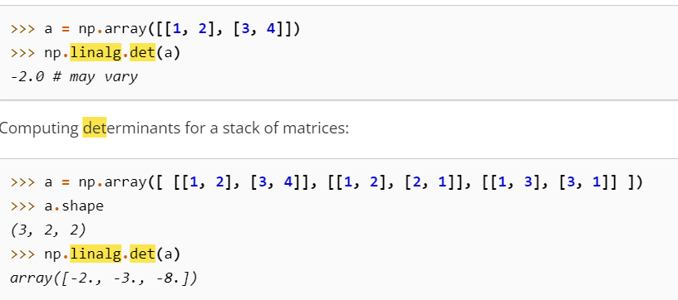
2.1. Numpy Functions used in the project
np.linalg.det: Computes the determinant of an array.

Slide 34
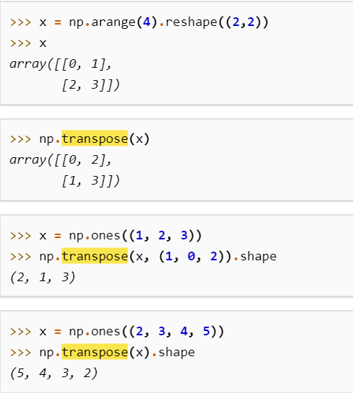
2.1. Numpy Functions used in the project
numpy.transpose: Transposes a matrix.

Slide 35
3. Matplotlib
Matplotlib is a cross-platform, data visualization and graphical plotting library for Python and NumPy.
It is built as an open-source alternative to MATLAB.
Matplotlib is dependent on Numpy to operate, and is often used with Pandas.
Matplotlib’s Pyplot API is a popular, intuitive API that helps display data in plots, graphs, and charts in Python.

Slide 36
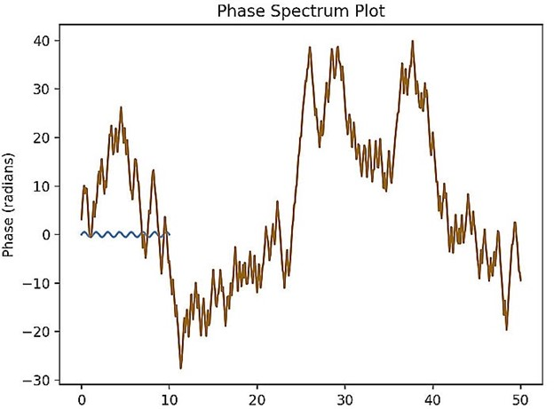
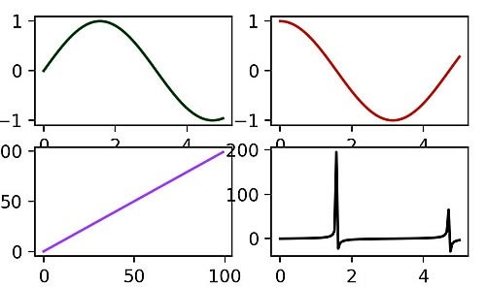
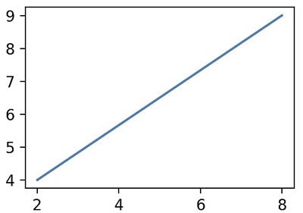
Examples of Pyplot graphs:

Slide 37
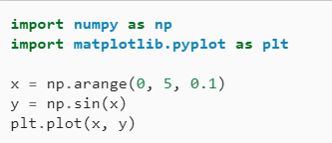
3.1. Matplotlib Functions used in the project
mplt.pyplot: Is a state-based interface to matplotlib. Provides an implicit, MATLAB-like, way of plotting. Mainly intended for interactive plots and simple cases of programmatic plot generation.

Slide 38
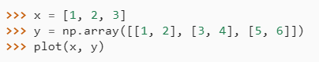
3.1. Matplotlib Functions used in the project
mplt.plot: Plots y versus x as lines and/or markers.

Slide 39
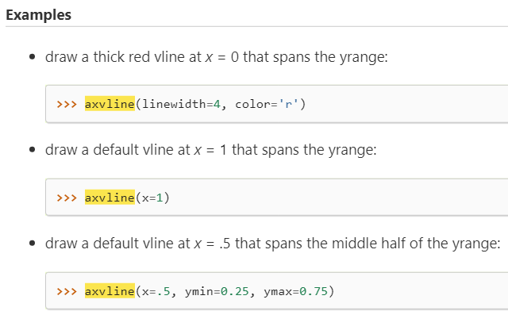
3.1. Matplotlib Functions used in the project
mplt.axvline: Adds a vertical line across the Axes.

Slide 40
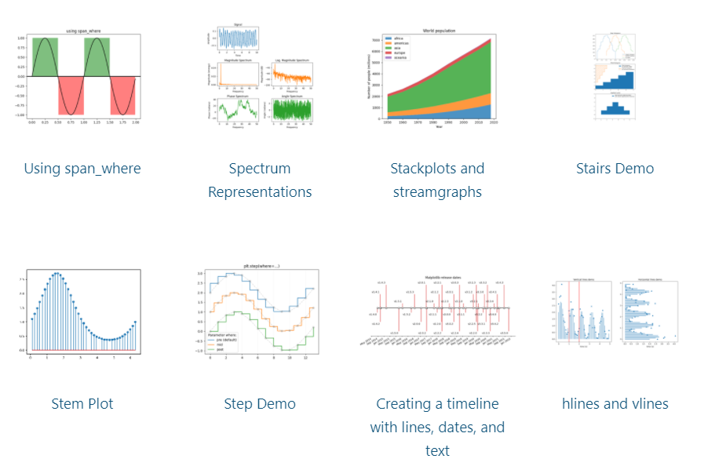
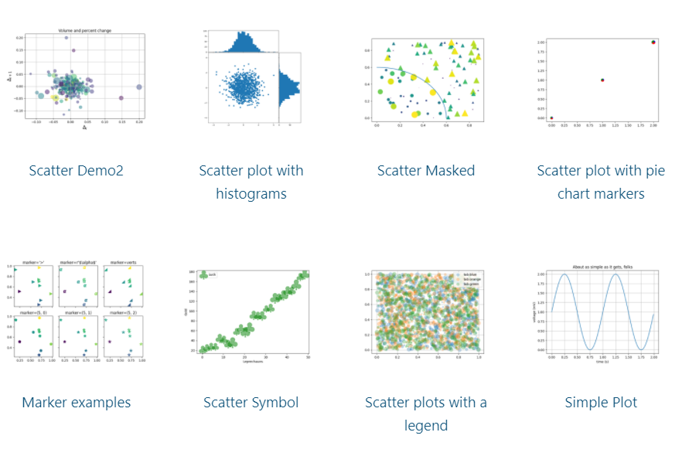
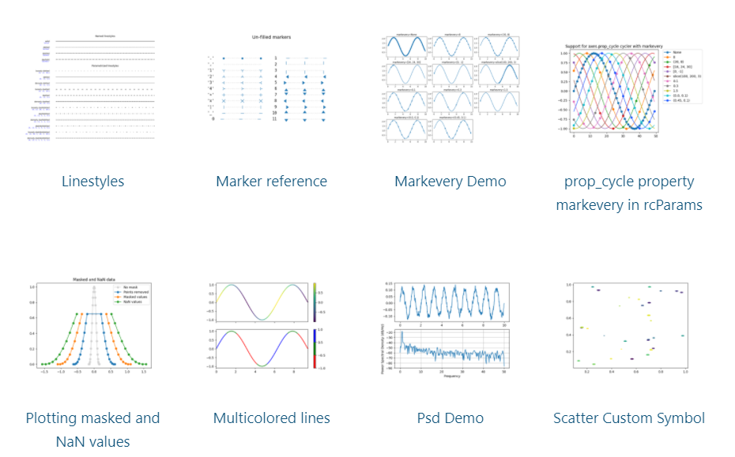
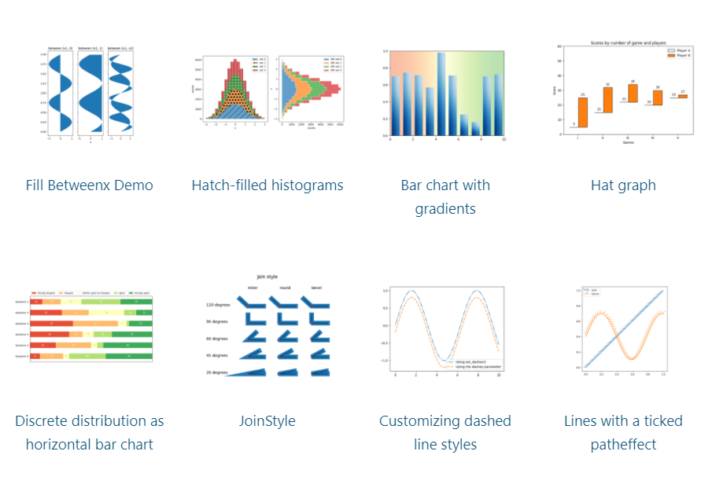
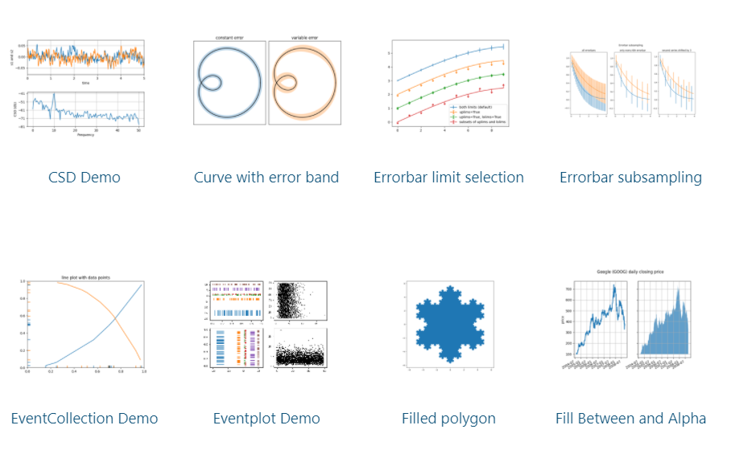
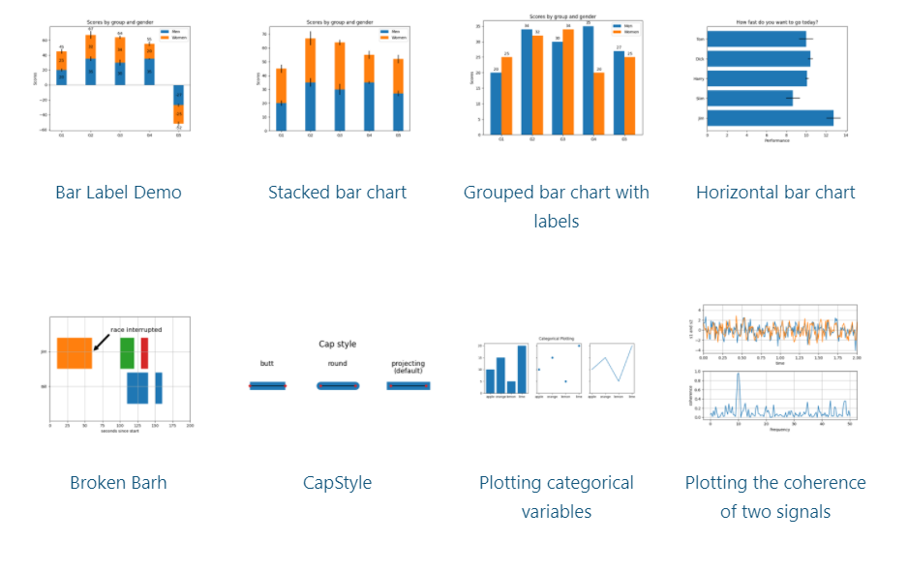
3.1. Matplotlib Functions used in the project
mplt.show: Displays all open figures.

Slide 41
4. Sympy
SymPy is an open-source Python library for symbolic computation. It provides computer algebra capabilities either as a standalone application, as a library to other applications, or live on the web as SymPy Live or SymPy Gamma. SymPy is simple to install and to inspect because it is written entirely in Python with few dependencies. This ease of access combined with a simple and extensible code base in a well known language make SymPy a computer algebra system with a relatively low barrier to entry.
SymPy includes features ranging from basic symbolic arithmetic to calculus, algebra, discrete mathematics, and quantum physics. It is capable of formatting the result of the computations as LaTeX code.

Slide 42
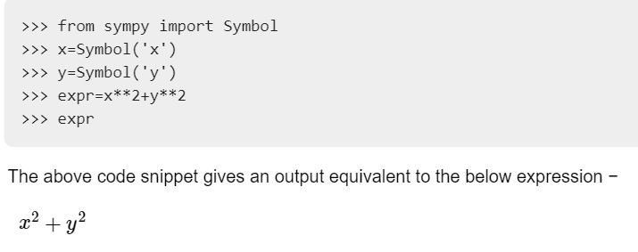
4.1. sympy Functions used in the project
sympy.Symbol: Is the most important class in symPy library. Enables all symbolic calculations.

Slide 43
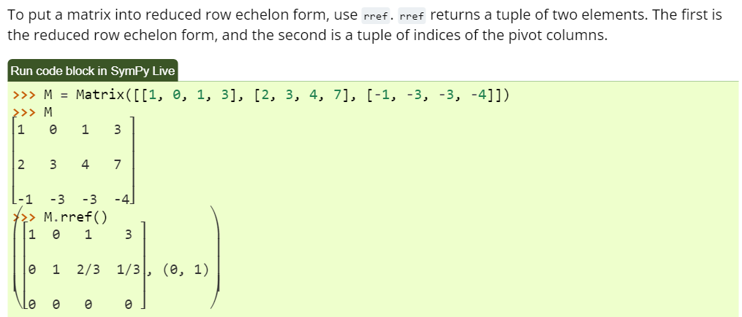
4.1. sympy Functions used in the project
sp.rref: Used to put matrices into reduced row echelon form.

Slide 44
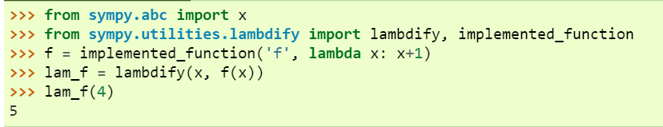
4.1. sympy Functions used in the project
sp.lambdify: Used to transform sympy expressions to lambda functions for ease of computing.

Slide 45
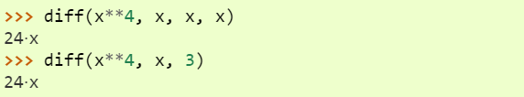
4.1. sympy Functions used in the project
sp.diff: Used to take derivatives of a function.

Slide 46
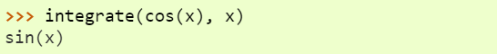
4.1. sympy Functions used in the project
sp.integrate: used to find the indefinite integral of a function.

Slide 47
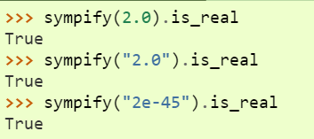
4.1. sympy Functions used in the project
sp.sympify: Converts an arbitrary expression to a type that can be used inside SymPy.

Slide 48
5. Pandas
Pandas is an open source Python package that is most widely used for data science/data analysis and machine learning tasks.
It is built on top of another package named Numpy, which provides support for multi-dimensional arrays.
Pandas works well with many other data science modules inside the Python ecosystem, and is typically included in every Python distribution.

Slide 49

5.1 Pandas functions used in the project
pd.DataFrame: Creates a two-dimensional, size-mutable, potentially heterogeneous tabular data. Data structure also contains labeled axes (rows and columns). Arithmetic operations align on both row and column labels. Can be thought of as a dict-like container for Series objects. The primary pandas data structure.

Slide 50

6. Other functions used in the project.
Time.sleep: Delays the execution of a current thread for a set amount of time.
A simple clock program using time.sleep

Slide 51
Thank you for listening.

